Slide 1

Crisis Connect :Disaster Management System
- Empowering Communities and Mobilizing Help
BY:
Anvesh(160122737056)
Tomson(160122737056)

Slide 2
Abstract:
Crisis Connect is a robust disaster management platform that seamlessly integrates real-time disaster reporting, volunteer coordination, and fundraising functionalities within a unified and intuitive interface. Leveraging the power of the MERN stack (MongoDB, Express.js, React, Node.js), the project ensures scalability, reliability, and user-friendliness.
At its core, Crisis Connect aims to revolutionize disaster management by facilitating community engagement and providing essential tools for efficient disaster response. By harnessing the collective power of volunteers, donors, and affected communities, the platform strives to enhance disaster management efficiency and resilience in the face of adversity.
Through its comprehensive suite of features, including real-time reporting of crisis situations, streamlined volunteer coordination, and intuitive fundraising mechanisms, Crisis Connect empowers users to make a meaningful impact during times of need. By fostering collaboration and solidarity, the platform paves the way for a more effective and compassionate approach to disaster management.

Slide 3

Introduction
Increasing frequency and severity of natural and man-made disasters.
The critical need for a coordinated and efficient disaster management system.
Crisis Connect aims to address this need by providing a platform for real-time reporting, volunteer coordination, and fundraising.

Slide 4

Literature Survey
Review of existing disaster management systems (e.g., FEMA, Google Crisis Map).
Analysis of platforms like GoFundMe for fundraising and All Hands and Hearts for volunteer coordination.
Identification of gaps and inefficiencies in current systems (e.g., lack of integration, limited accessibility).

Slide 5
Existing System
Government and NGO-led platforms: Focus on information and resource management but often lack integration.
Fundraising platforms: Efficient for raising funds but not integrated with volunteer management and real-time reporting.
Volunteer management systems: Good at coordinating volunteers but lack seamless integration with fundraising and disaster reporting.

Slide 6
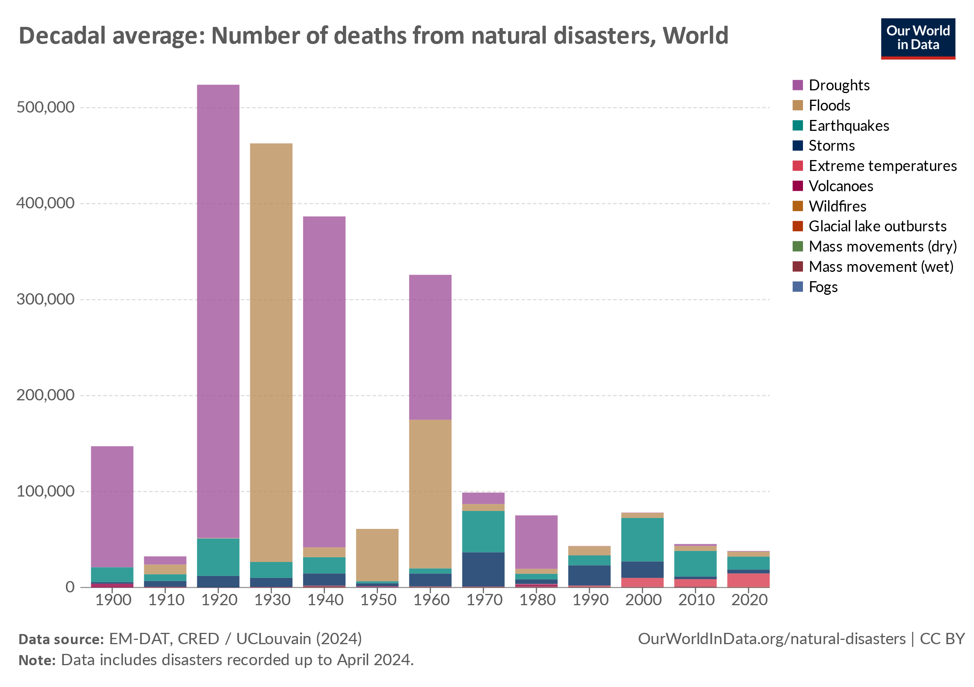
Methodology/Proposed System: Crisis Connect
Functional Requirements:
Real-time disaster reporting and notification.
Volunteer management and coordination.
Fundraising and resource management.
Real-time data analytics and reporting.
Geolocation services.
Non-Functional Requirements:
Scalability, security, reliability, usability, performance, interoperability, and maintainability.

Slide 7

System Design:
User Interface: Clean, intuitive dashboards for disasters, volunteers, and donors. Users friendly navigations.
Database Design: MongoDB for flexible, scalable data management
Schema Design : For various entities
Ex: Collections of Users, Disasters , Volunteers, Donations

Slide 8
Result
Successful development and deployment of Crisis Connect using the MERN stack.
Real-time disaster reporting and notification system in place.
Efficient volunteer management and coordination capabilities.
Transparent and effective fundraising and resource management.

Slide 9
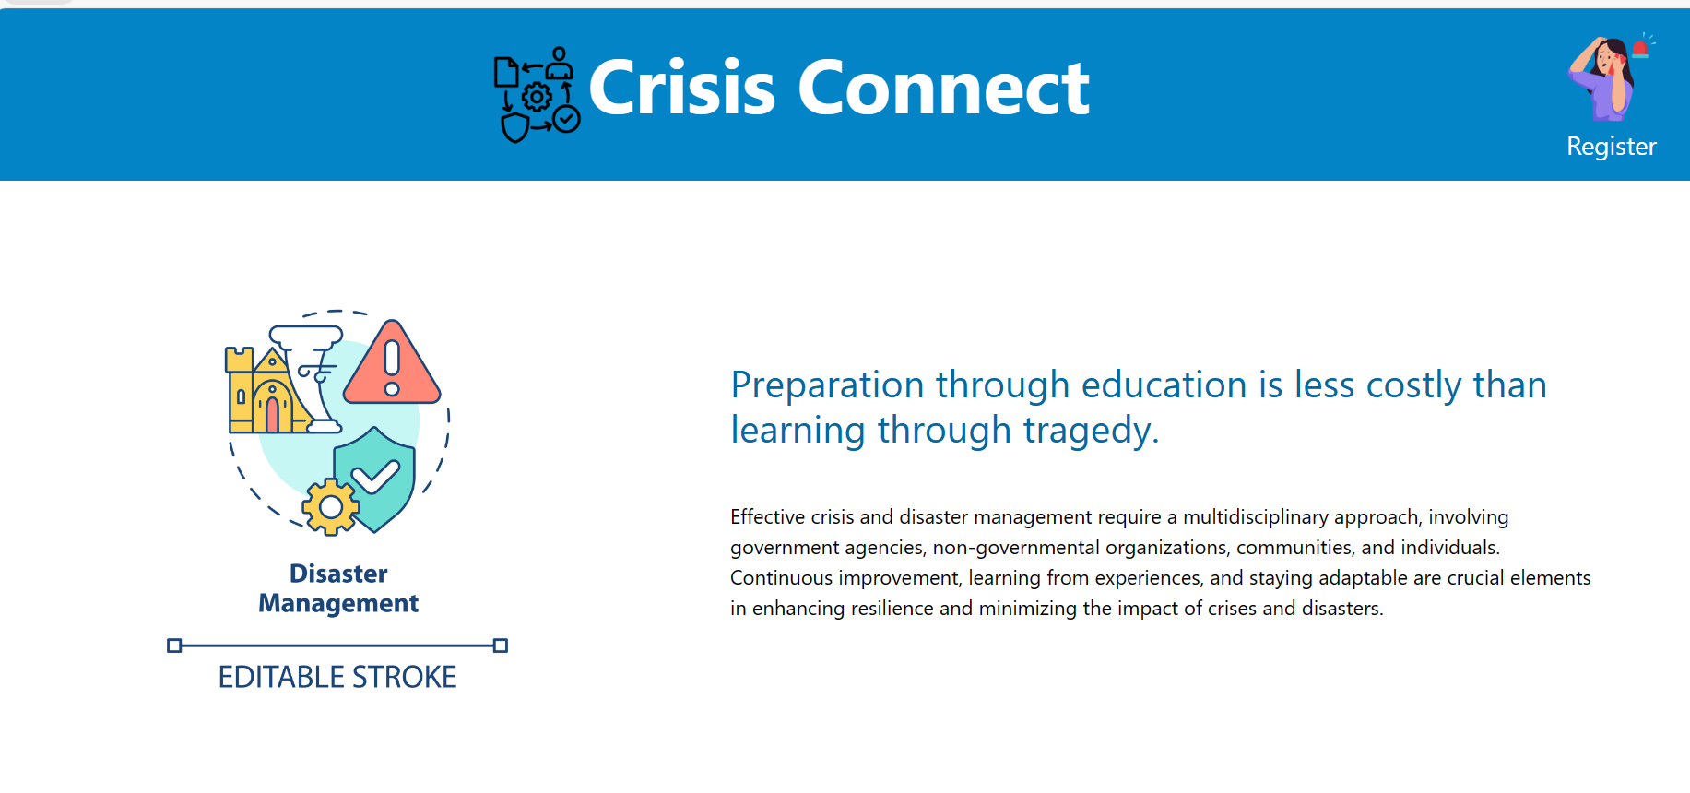

Slide 10
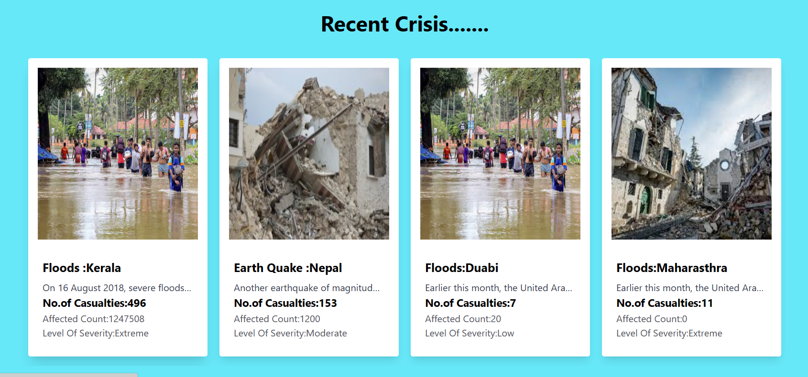
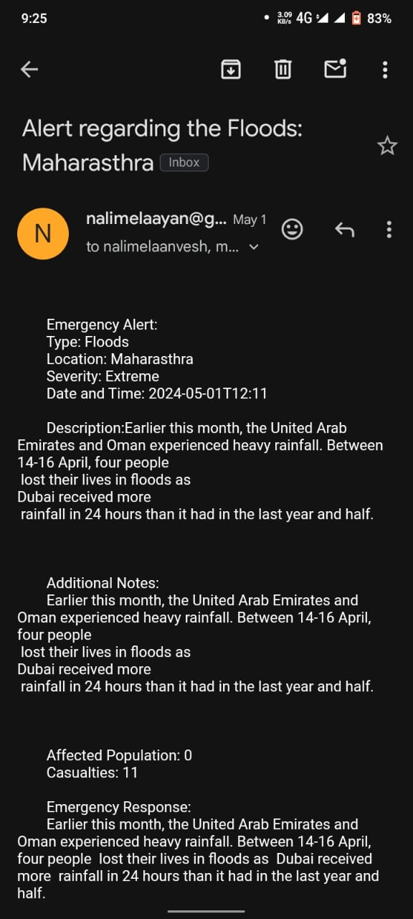
Recent Crisis And Mail Notification

Slide 11
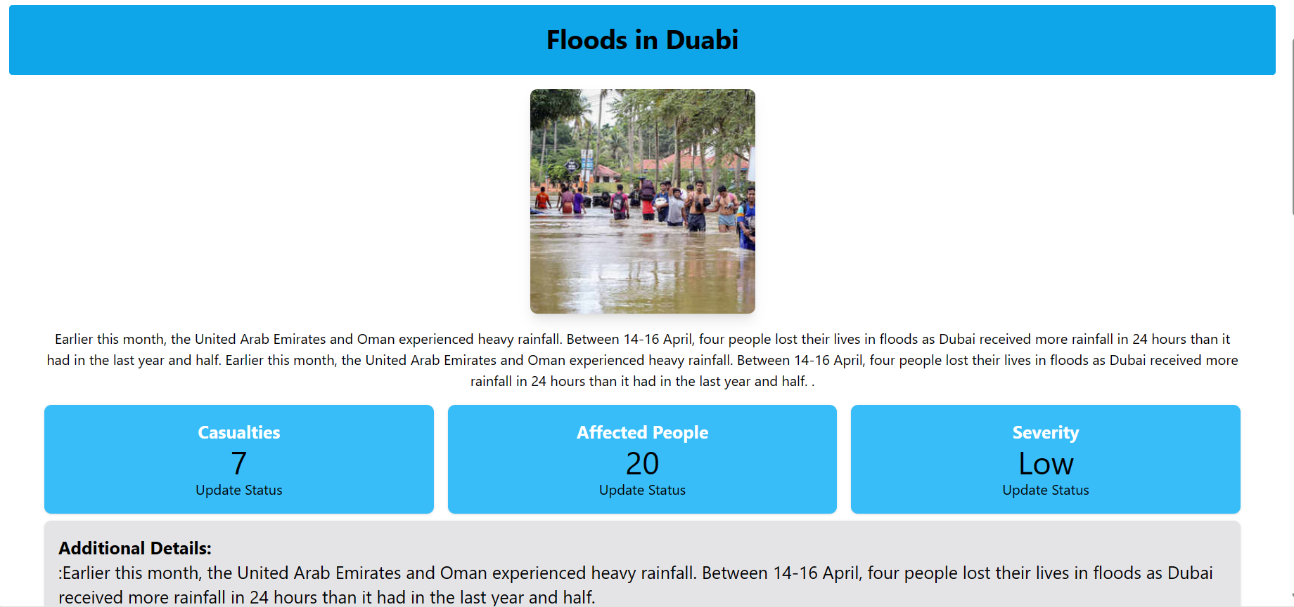
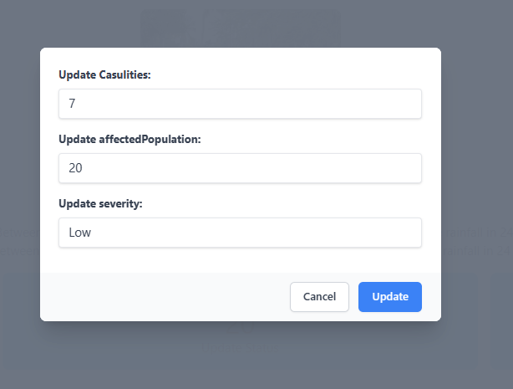
Detail view of disaster

Slide 12

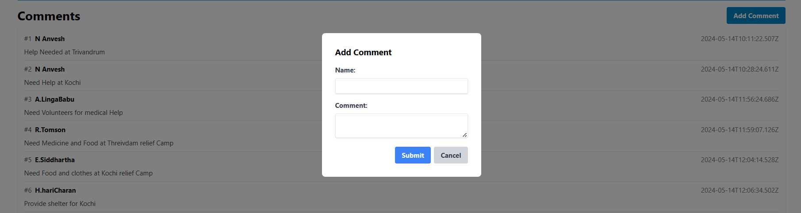

Slide 13
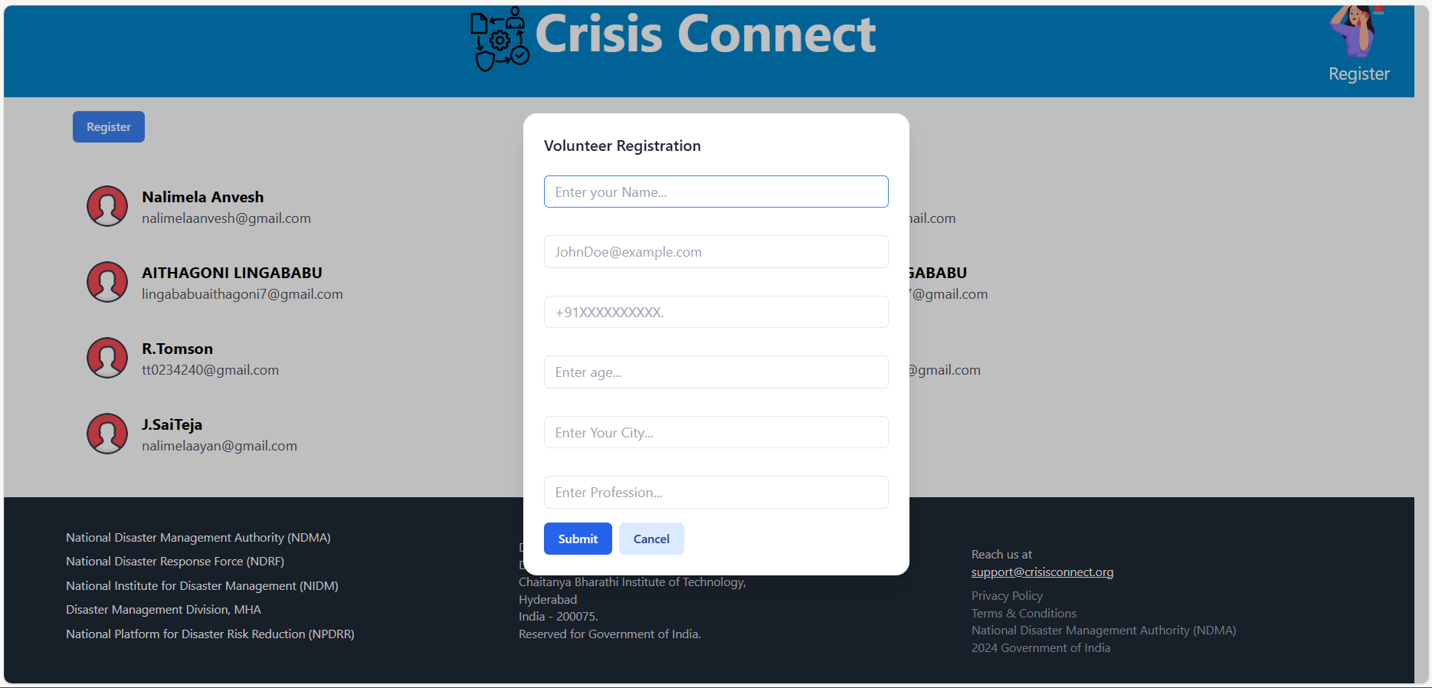
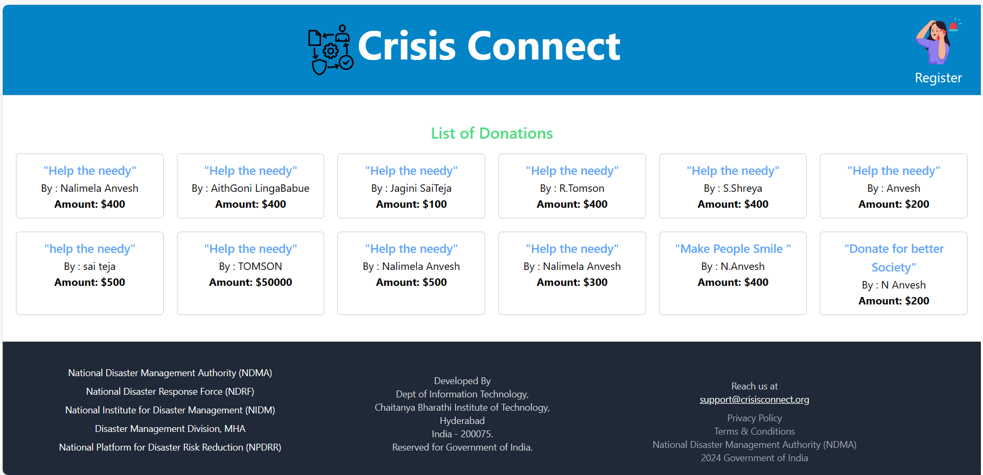
Donors and Volunteers

Slide 14
Conclusion
Crisis Connect provides a holistic solution to disaster management by integrating real-time reporting, volunteer coordination, and fundraising.
The platform enhances the efficiency and effectiveness of disaster response efforts, fostering community engagement and resilience.
Future enhancements will focus on AI for disaster prediction, mobile app development, global expansion, and blockchain for transparency.

Slide 15
REFERENCES:
EM-DAT: The International Disaster Database
FEMA Disaster Management System
Google Crisis Map
All Hands and Hearts – Volunteer Coordination Platform
MongoDB Documentation
Node.js Official Documentation
Express.js Official Documentation
React.js Official Documentation
Google
ChatGPT

